Slide 1
CS211 Computer Architecture Lecture 38: Cache – 4 : Cache Memory Performance
Ravi Mittal
ravi.mittal@iitgoa.ac.in
Indian Institute of Technology, Goa

Slide 2
Acknowledgements
Krste Asanović & Randy H. Katz, CS 61C: Great Ideas in Computer Architecture (Machine Structures), http://inst.eecs.berkeley.edu/~cs61c/
Chapter 6, Memory Hierarchy, Book: Computer Systems: A programmer’s perspective, Randal E. Bryant and David R. O’Hallaron
Prof Onur Mutlu’s Class Presentation, ETH Zürich, Lecture 21b: Memory Hierarchy and Caches, Sprint 2020
Patterson and Hennessy, Book: Computer Organization and Design, Hardware/Software Interface, RISC-V Edition
MIT 6.004 Spring 2020, Class on Caches
Digital Design and Computer Architecture: RISC-V Edition, Harris & Harris Elsevier

Slide 3
In this class we will study
Cache Memory – Performance
Understanding Cache Misses
Average Memory Access Time (AMAT)
Pipelined Datapath with Cache Memory

Slide 4
Cache Memory: Performance

Slide 5
Cache Performance Metrics
Hit Rate
Percentage of memory accesses in a program or set of instructions that result in a cache hit
In cache, which is almost million times smaller than MM, the hit rate is 90%-95% (eg 4KiB cache vs 4 GiB Main Memory)
Hit Rate = No of hits / No of memory accesses
= 1 – Miss Rate
Miss Rate
Fraction of memory references that are not found in cache (misses / accesses) = 1 – hit rate
Typical numbers (in percentages):
3-10% for L1
Can be quite small (e.g., < 1%) for L2, depending on size, etc.
Miss Penalty
Time it takes to service a miss
Additional time required because of a miss (to replace a block in the cache from lower level)
Typically 1000 cycles for main memory

Slide 6
Cache Performance Metrics
Hit Time
Time to deliver a line (block) in the cache to the processor
Includes time to determine whether the line is in the cache (tag comparison)
Note that cache is a circuit structure that sits inside core of the processor. It’s critical path component for the processor
Cache has to be properly chosen so that it doesn’t impact the cycle time of the processor
Hit time of the cash is in nano seconds – usually one fourth of a cycle

Slide 7
Understanding Cache Misses

Slide 8
Types of Cache Misses
Cold (compulsory) miss
Cold misses occur because the cache starts empty and this is the first reference to the block
Cold fact of life: not a whole lot you can do about it
If you are going to run “billions” of instruction, Compulsory Misses are insignificant
Capacity miss
Occurs when the set of active cache blocks (working set) is larger than the cache
Solution: increase cache size
Bryant and O’Hallaron, Computer Systems: A Programmer’s Perspective, Third Edition

Slide 9
Types of Cache Misses
Conflict (Collision) miss
Multiple memory locations mapped to the same cache location
Block i at level k+1 must be placed in block (i mod 4) at level k
Conflict misses occur when the level k cache is large enough, but multiple data objects all map to the same level k block.
E.g. Referencing blocks 0, 8, 0, 8, 0, 8, ... would miss every time
Solution 1: increase cache size
Solution 2: increase associativity

Slide 10
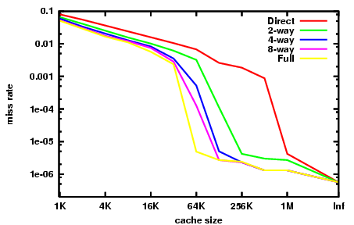
Miss Rate vs. Cache Size on the Integer Portion of SPECCPU2000

Slide 11
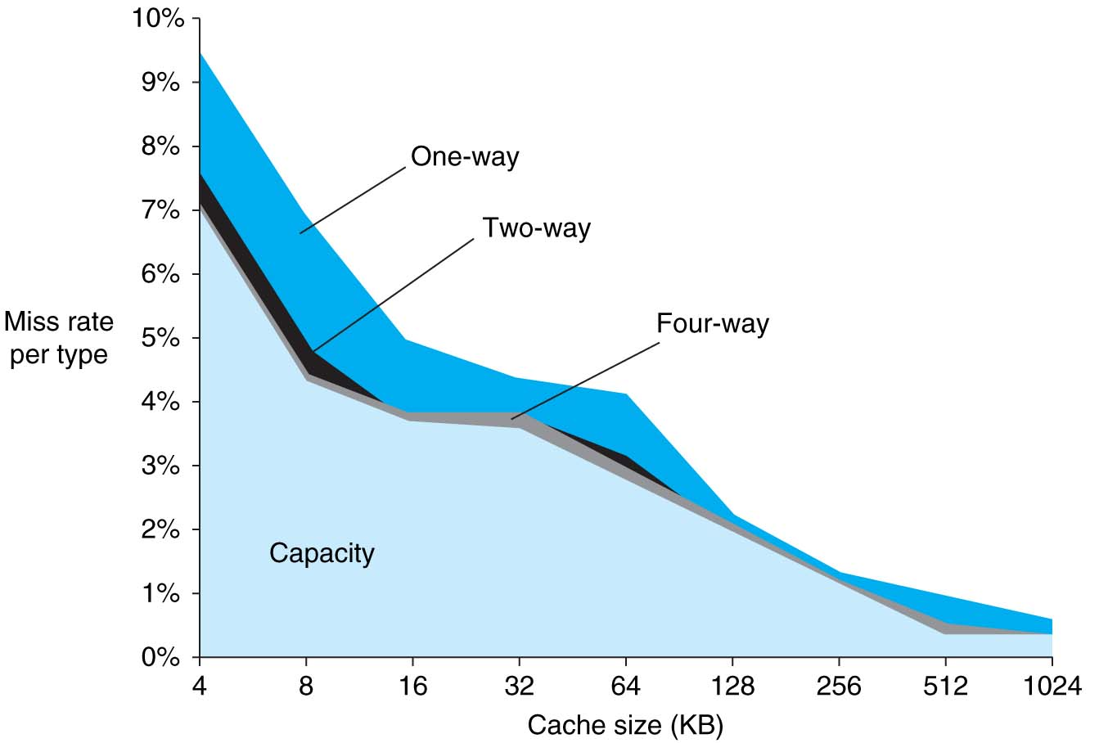
3Cs Analysis
Three sources of misses (SPEC2000 integer and floating-point benchmarks)
Compulsory misses 0.006%; not visible
Capacity misses, function of cache size
Conflict portion depends on associativity and cache size

Slide 12
Average Memory Access Time (AMAT)

Slide 13
Memory Performance
Memory Performance
Average memory access time (AMAT): average time for processor to access memory considering both hits and misses
How to reduce AMAT?
AMAT = Time for a hit + Miss rate × Miss penalty

Slide 14
How to reduce AMAT?
Reduce the time to hit in the cache
Reduce cache size → hit time decreases
Decrease associativity → decrease in the number of sets → less time due to less tag-matching
Direct mapped Cache has low hit time
Reduce the miss rate: Miss rate depends on access patterns
Larger cache, Larger block sizes, more associativity
Reduce the miss penalty
Example: Use multiple cache levels

Slide 15
Reducing Miss Rate: 3Cs
Reducing Compulsory Misses
Difficult to avoid
One technique: Prefetching
Reducing Capacity Misses
Increase cache size
It may increase Hit Time
Reducing Conflict Misses
Increase associativity
Fully associative cache has low miss rate
However it may increase Hit Time

Slide 16
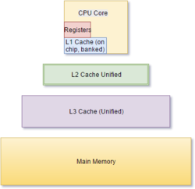
Reducing Miss Penalty
“Cost” (usually in cycles, or fractions of a second of a miss)
Going to the next level of cache
Contributing factors:
How “big” is your memory hierarchy?
Good probability of finding things at a level
Smaller block size → lower MP
There are many smart techniques to reduce miss penalty
Use of Write buffers
Sub-block placement
Early restart and critical word first
Multilevel cache

Slide 17
AMAT Example
Processor specs: 200 ps clock, Miss Penalty of 50 clock cycles, Miss Rate of 0.02 misses/instruction, and Hit Time of 1 clock cycle
AMAT = 1 + 0.02 * 50 = 2 clock cycles = 400 ps
Which improvement would be best?
190 ps clock
2 cycles = 2*190 = 380
Miss Penalty of 40 clock cycles
1 + 0.02 * 40 = 360
Miss Rate of 0.015 misses/instruction
1 + .15 * 50 = 350

Slide 18
Multilevel Cache Design Considerations
L1 cache focuses on low hit time (fast access)
minimize Hit Time to achieve shorter clock cycle
L1 Miss Penalty significantly reduced by presence of L2 cache
→ L1 Cache can be smaller/faster even with higher miss rate
smaller cache has fewer rows
L2, L3 caches focus on low miss rate
As much as possible avoid reaching to main memory (heavy penalty)
larger caches with larger block sizes (same # rows)

Slide 19
Multilevel Cache AMAT
AMAT = L1 HT + L1 MR × L1 MP
Now L1 MP depends on other cache levels
Must trace ENTIRE path to memory
L1 MP = L2 HT + L2 MR × L2 MP
If more levels, then continue this chain (i.e. MPi = HTi+1 + MRi+1 × MPi+1)
Final MP is main memory access time
For two levels:
AMAT = L1 HT + L1 MR × (L2 HT + L2 MR × L2 MP)

Slide 20
Cache Design Space
Computer architects expend considerable effort optimizing organization of cache hierarchy – big impact on performance and power!
Several interacting dimensions
Cache size
Block size
Associativity
Replacement policy
Write-through vs. write-back
Write allocation
Optimal choice is a compromise
Depends on access characteristics
Workload
Use (I-cache, D-cache)
Depends on technology / cost
Simplicity often wins
Cache Size
Associativity
Block Size
Bad
Good
Factor A
Factor B
Less
More
Notes:
No fancy replacement policy is needed for the direct mapped cache.
As a matter of fact, that is what cause direct mapped trouble to begin with: only one place to go in the cache--causes conflict misses.
No fancy replacement policy is needed for the direct mapped cache.
As a matter of fact, that is what cause direct mapped trouble to begin with: only one place to go in the cache--causes conflict misses.
Besides working at Sun, I also teach people how to fly whenever I have time.
Statistic have shown that if a pilot crashed after an engine failure, he or she is more likely to get killed in a multi-engine light airplane than a single engine airplane.
The joke among us flight instructors is that: sure, when the engine quit in a single engine stops, you have one option: sooner or later, you land. Probably sooner.
But in a multi-engine airplane with one engine stops, you have a lot of options. It is the need to make a decision that kills those people.

Slide 21
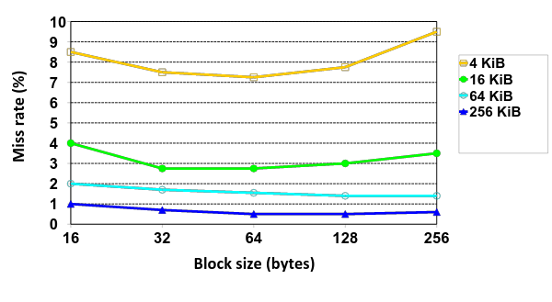
Effect of Block and Cache Sizes on Miss Rate
Cache Size
Miss rate goes up if the block size becomes a significant fraction of the cache size because the number of blocks that can be held in the same size cache is smaller
Notes:
Increasing the block size usually decreases the miss rate.
A more serious problem is that the miss penalty goes up since it is primarily determined by the time to fetch the block from the next lower level of the hierarchy and load it into the cache.

Slide 22
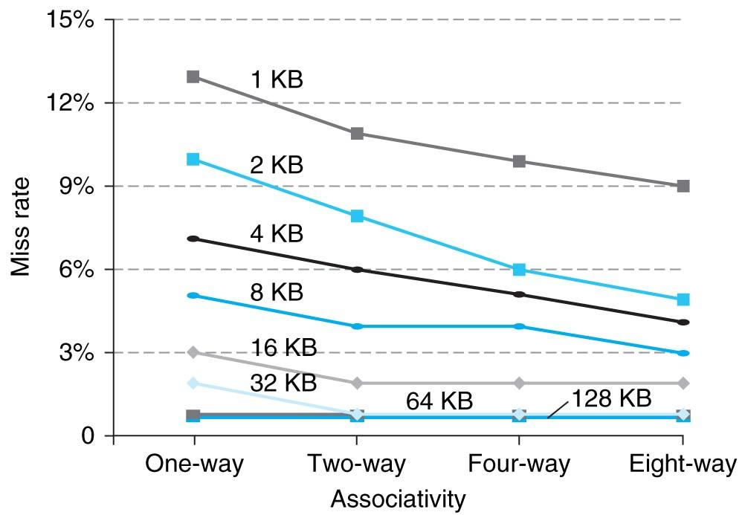
Benefits of Set-Associative Caches
Consider cost of a miss vs. cost of implementation
Largest gains are in going from direct mapped to 2-way (20%+ reduction in miss rate)
As cache size grows the relative improvement from associativity increases slightly
Notes:
As cache sizes grow, the relative improvement from associativity increases only slightly; since the overall miss rate of a larger cache is lower, the opportunity for improving the miss rate decreases and the absolute improvement in miss rate from associativity shrinks significantly.

Slide 23
Impact of Larger Cache on AMAT?
Reduces misses
Longer Access time (Hit time): smaller is faster
Increase in hit time will likely add another stage to the pipeline
At some point, increase in hit time for a larger cache may overcome improvement in hit rate, yielding a decrease in performance
Computer architects expend considerable effort optimizing organization of cache hierarchy – big impact on performance and power!
Notes:
AMAT = 1 + 0.02x50 = 2

Slide 24
Increasing Block Size (self reading)
Hit time remains unchanged as block size increases
There might be slight hit-time reduction as number of tags is reduced, so faster to access memory holding tags
Miss rate goes down first due to increase in spatial locality, then it increases due to increased conflict misses as a fewer blocks are in cache
Miss penalty rises as block size increases

Slide 25
Increasing Associativity? (self reading)
Increases Hit time increases as associativity increases
Increases, with large step from direct-mapped to >=2 ways
Use of mux – increase hit time
Miss rate goes down as associativity increases
Goes down due to reduced conflict misses, but most gain is from 1->2->4-way with limited benefit from higher associativities
Miss penalty remains unchanged associativity increases
replacement policy runs in parallel with fetching missing line from memory

Slide 26
Pipelined datapath with Cache Memory

Slide 27
Pipelined RISC-V RV32I Datapath (with Instruction and Data Caches)
Recalculate PC+4 in M stage to avoid sending both PC and PC+4 down pipeline
pc_{X}
pc_{M}
pc_{F}
pc_{D}
+4
+4
Reg[]
rs1_{X}
1
DataD
DataA
ALU
DMEM
alu_{X}
0
AddrD
Branch Comp.
alu_{M}
Addr
DataR
pc_{F}+4
IMEM
AddrA
DataW
“Bubble”
AddrB
DataB
Primary D$
pc_{F}
Primary I$
inst_{D}
rs2_{M}
Addr DataR
DataW
Addr Instr
rs2_{X}
imm_{X}
inst_{D}
Imm.
Hit?
inst_{X}
inst_{M}
Hit?
PC_{en}
inst_{W}
To Memory Controller
Memory Controller & Stall entire CPU on D$ miss
Write Back/Thru to Memory
Refill $ Data from Lower Levels of Memory Hierarchy
Refill D$ data from Lower Levels of Memory Hierarchy
Must pipeline instruction along with data, so control operates correctly in each stage

Slide 28
Summary
Cache performance depends heavily on cache design
Parameters that effect Cache performance
Cache Size
Block Size
Associativity
Replacement policies
Cache organization – Write through vs Write back, Write allocate vs Write no allocate
Cache performance vs cost

Slide 29
Multilevel Cache Diagram
Legend:
Request for data
Return of data
Main Memory
L2$
Write Miss
L1$
Write Miss
CPU
Memory
Access
Miss
Miss
.
.
.
Return
Hit
Hit
Store
Store
Path of data back to CPU
If Write Allocate
Notes:
The stores back in higher-level caches depends on your write-miss policy (write allocate or no-write allocate).

